Slide 1
NATURAL LANGUAGE PROCESSING
DEPARTMENT OF CSE-AIML (CSM) – III-II Sem
NATURAL LANGUAGE PROCESSING

Slide 2
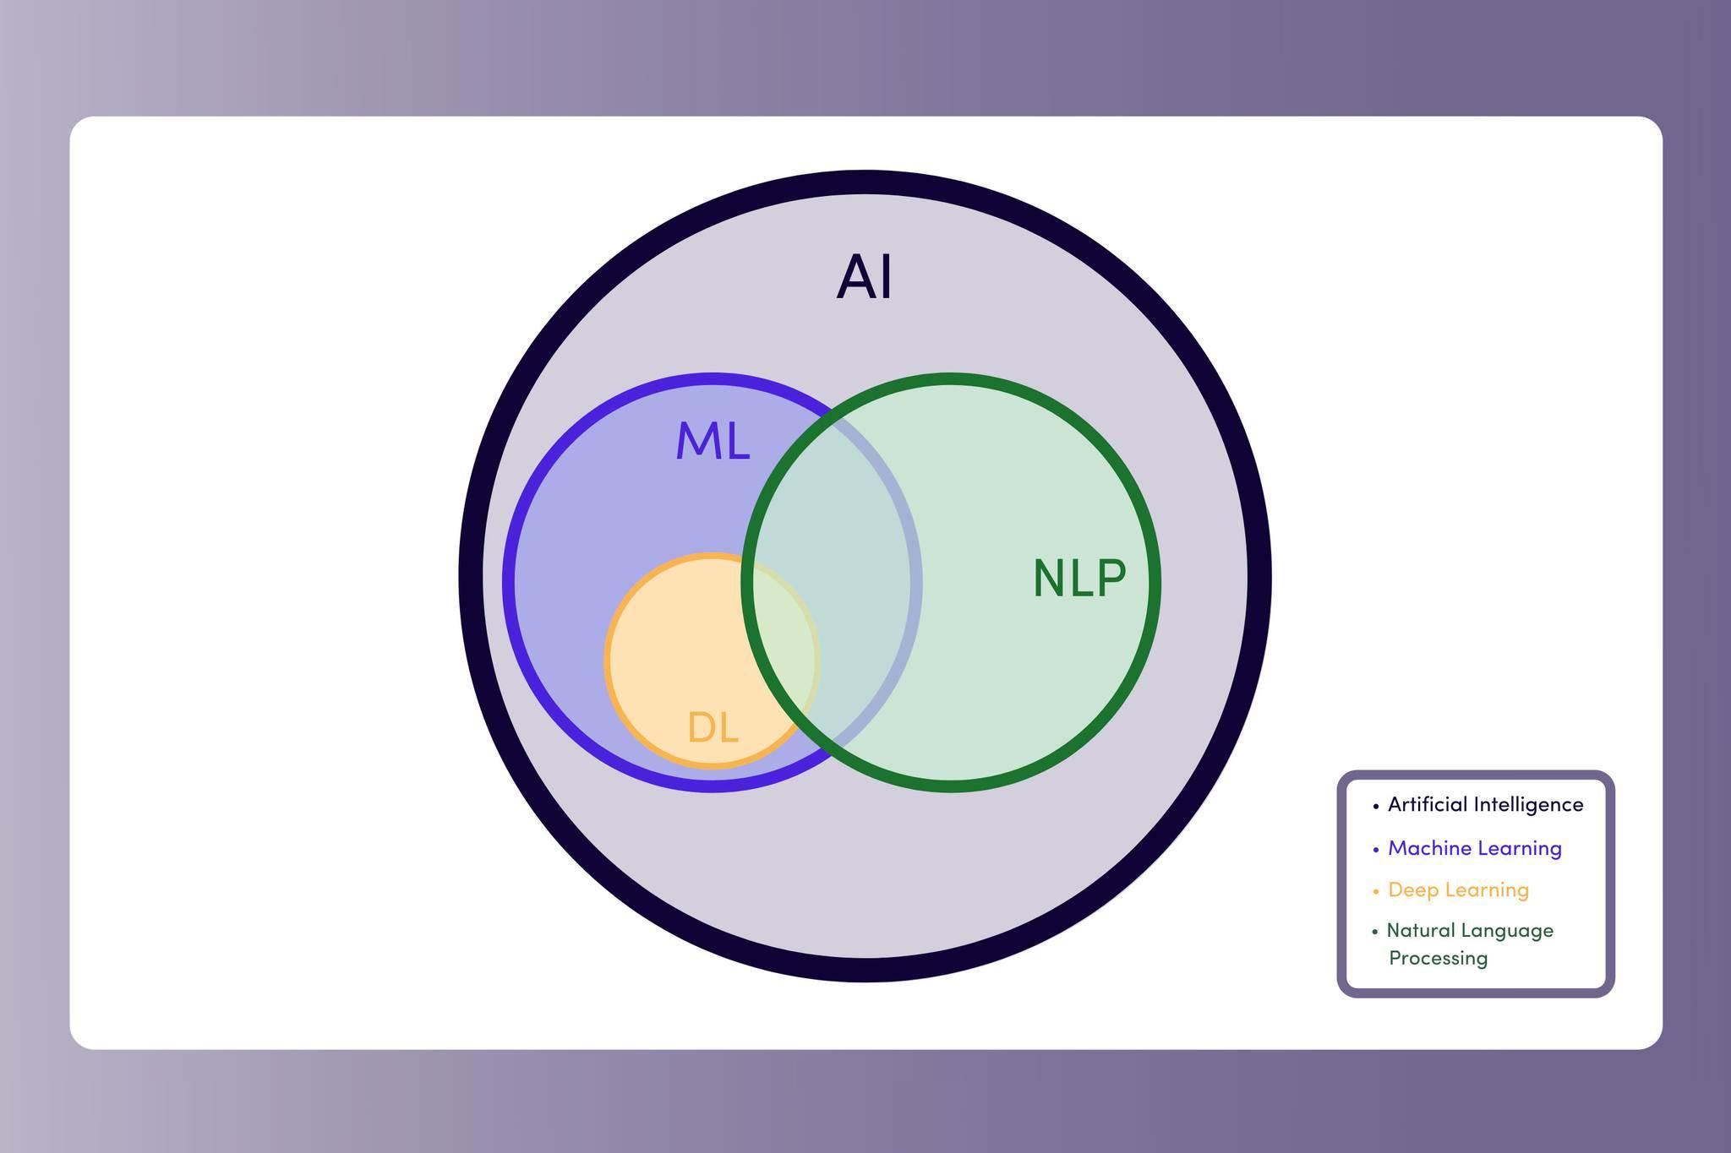
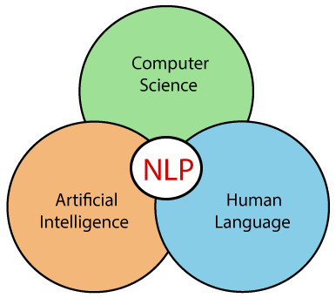
This Session Learning Objectives 1. Introduction 2.Motivations 3.NLP? 4.Roadmap for NLP 5. NLP Components 6.NLP Issues 7. NLP Techniques 8.NLP Applications. 9. The role of Deep Learning in Natural Language Processing 10. Backpropagations, recurrent neural networks, Transformers. .
DEPARTMENT OF CSE-AIML (CSM) – III-II Sem
NATURAL LANGUAGE PROCESSING
Introduction to NLP:

Slide 3
This Session Learning Objectives 1. Introduction 2.Motivations 3.NLP? 4.Roadmap for NLP 5. NLP Components 6.NLP Issues 7. NLP Techniques 8.NLP Applications. 9. The role of Deep Learning in Natural Language Processing 10. Backpropagations, recurrent neural networks, Transformers. .
DEPARTMENT OF CSE-AIML (CSM) – III-II Sem
NATURAL LANGUAGE PROCESSING
Introduction to NLP:
NLP would be to program computers for analyzing and processing huge amount of natural language data.
It is a challenge for us to develop NLP applications because computers need structured data, but human speech is unstructured and often ambiguous in nature.
Study of Human Languages, Language is a crucial component for human lives and also the most fundamental aspect of our behavior.
Written and Spoken.

Slide 4
DEPARTMENT OF CSE-AIML (CSM) – III-II Sem
NATURAL LANGUAGE PROCESSING
NLP - Motivation :
The goal is to show you what is possible with current NLP techniques.
It inspire you to use some of these applications for your own.
Automatic text summarization : https://www.summarizebot.com/text_api_demo.html
2. Question answering : https://twitter.com/paraschopra/status/1284801028676653060?ref_src=twsrc%5Etfw%7Ctwcamp%5Etweetembed%7Ctwterm%5E1284801028676653060%7Ctwgr%5E89ef6d98baf71853523d6979e82ddbbc35d094f2%7Ctwcon%5Es1_&ref_url=https%3A%2F%2Fcdn.iframe.ly%2FyFGbULo%3Fapp%3D1
This Session Learning Objectives 1. Introduction 2.Motivations 3.NLP? 4.Roadmap for NLP 5. NLP Components 6.NLP Issues 7. NLP Techniques 8.NLP Applications. 9. The role of Deep Learning in Natural Language Processing 10. Backpropagations, recurrent neural networks, Transformers. .

Slide 5
DEPARTMENT OF CSE-AIML (CSM) – III-II Sem
NATURAL LANGUAGE PROCESSING
NLP - Motivation :
The goal is to show you what is possible with current NLP techniques.
It inspire you to use some of these applications for your own.
3. Information extraction
https://demos.explosion.ai/displacy-ent
4. Text classification --
https://dandelion.eu/semantic-text/entity-extraction-demo/?text=The+Mona+Lisa+is+a+sixteenth+century+oil+painting+created+by+Leonardo.+It%27s+held+at+the+Louvre+in+Paris.&lang=en&min_confidence=0.6&exec=true#results
This Session Learning Objectives 1. Introduction 2.Motivations 3.NLP? 4.Roadmap for NLP 5. NLP Components 6.NLP Issues 7. NLP Techniques 8.NLP Applications. 9. The role of Deep Learning in Natural Language Processing 10. Backpropagations, recurrent neural networks, Transformers. .

Slide 6
DEPARTMENT OF CSE-AIML (CSM) – III-II Sem
NATURAL LANGUAGE PROCESSING
NLP - Motivation :
The goal is to show you what is possible with current NLP techniques.
It inspire you to use some of these applications for your own.
5. Machine Translation --
https://pbs.twimg.com/media/EdcIrZyXkAADjcG?format=png&name=large
6. Write Code using natural language
ex: https://twitter.com/i/status/1282676454690451457
This Session Learning Objectives 1. Introduction 2.Motivations 3.NLP? 4.Roadmap for NLP 5. NLP Components 6.NLP Issues 7. NLP Techniques 8.NLP Applications. 9. The role of Deep Learning in Natural Language Processing 10. Backpropagations, recurrent neural networks, Transformers. .

Slide 7
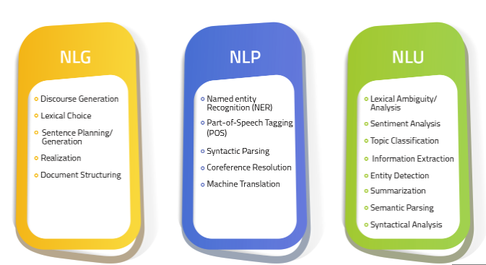
DEPARTMENT OF CSE-AIML (CSM) – III-II Sem
NATURAL LANGUAGE PROCESSING
NLP Components:
NLP=NLU+NLG
NLP identifies and processes the most significant data and structures it into text, numbers, or computer language
· NLU understands the human language and converts it into data
· NLG uses the structured data and generates meaningful narratives out of it
This Session Learning Objectives 1. Introduction 2.Motivations 3.NLP? 4.Roadmap for NLP 5. NLP Components 6.NLP Issues 7. NLP Techniques 8.NLP Applications. 9. The role of Deep Learning in Natural Language Processing 10. Backpropagations, recurrent neural networks, Transformers. .

Slide 8
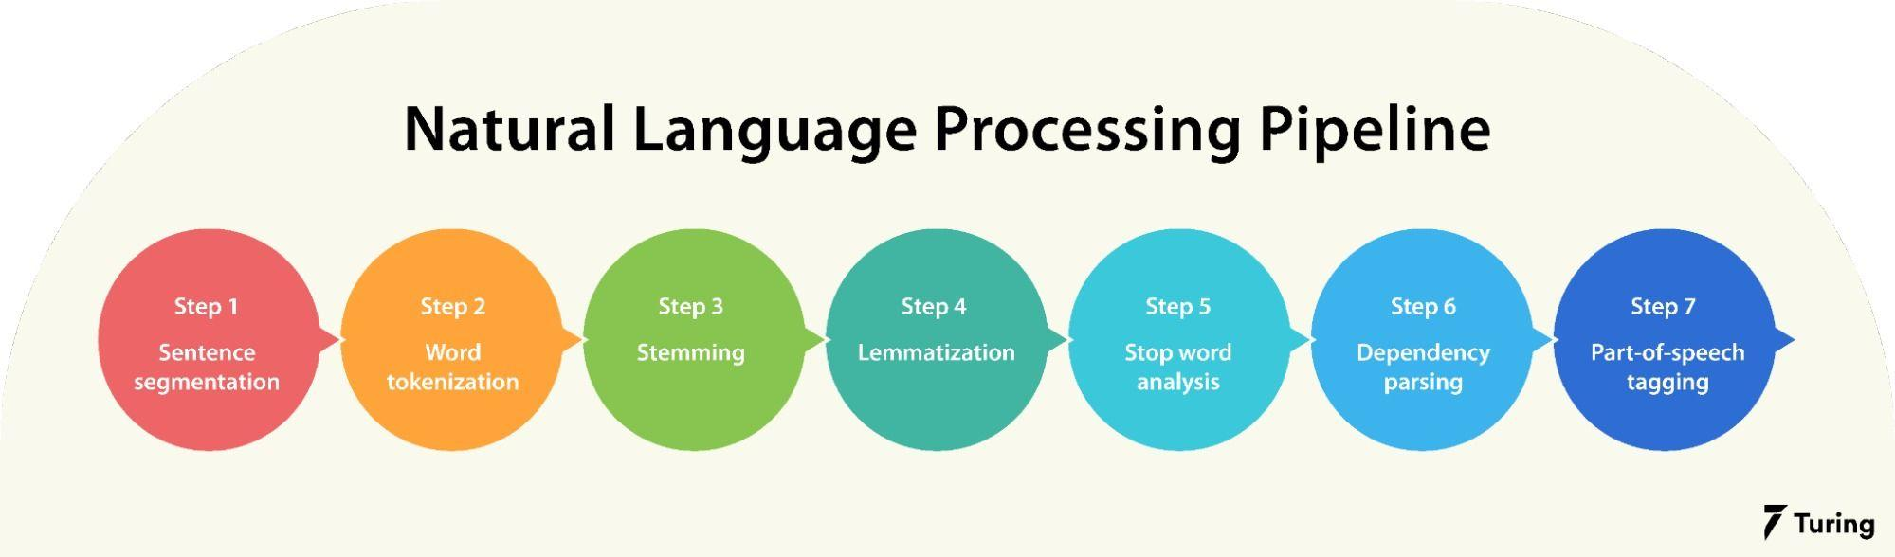
DEPARTMENT OF CSE-AIML (CSM) – III-II Sem
NATURAL LANGUAGE PROCESSING
Road Map:
This Session Learning Objectives 1. Introduction 2.Motivations 3.NLP? 4.Roadmap for NLP 5. NLP Components 6.NLP Issues 7. NLP Techniques 8.NLP Applications. 9. The role of Deep Learning in Natural Language Processing 10. Backpropagations, recurrent neural networks, Transformers. .

Slide 9
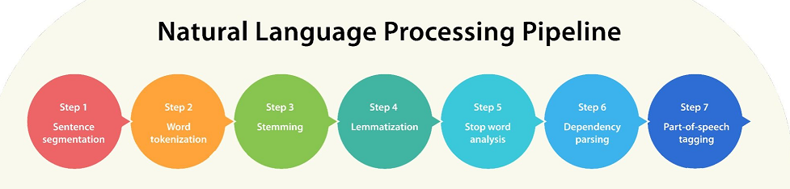
DEPARTMENT OF CSE-AIML (CSM) – III-II Sem
NATURAL LANGUAGE PROCESSING
NLP Pipeline:
This Session Learning Objectives 1. Introduction 2.Motivations 3.NLP? 4.Roadmap for NLP 5. NLP Components 6.NLP Issues 7. NLP Techniques 8.NLP Applications. 9. The role of Deep Learning in Natural Language Processing 10. Backpropagations, recurrent neural networks, Transformers. .

Slide 10
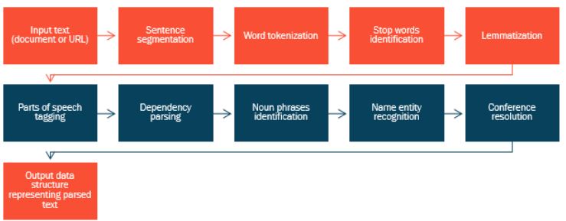
DEPARTMENT OF CSE-AIML (CSM) – III-II Sem
NATURAL LANGUAGE PROCESSING
NLP Pipeline:
This Session Learning Objectives 1. Introduction 2.Motivations 3.NLP? 4.Roadmap for NLP 5. NLP Components 6.NLP Issues 7. NLP Techniques 8.NLP Applications. 9. The role of Deep Learning in Natural Language Processing 10. Backpropagations, recurrent neural networks, Transformers. .

Slide 11
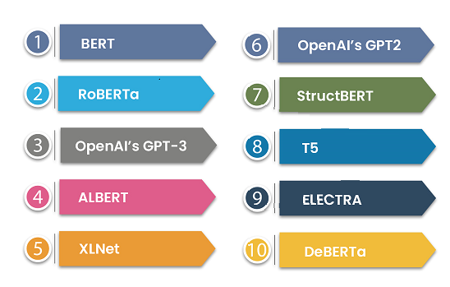
DEPARTMENT OF CSE-AIML (CSM) – III-II Sem
NATURAL LANGUAGE PROCESSING
NLP Applications:
Automatic text summarization
Question answering
Information extraction
Text classification
Machine Translation
Write Code using natural language
This Session Learning Objectives 1. Introduction 2.Motivations 3.NLP? 4.Roadmap for NLP 5. NLP Components 6.NLP Issues 7. NLP Techniques 8.NLP Applications. 9. The role of Deep Learning in Natural Language Processing 10. Backpropagations, recurrent neural networks, Transformers. .

Slide 12
DEPARTMENT OF CSE-AIML (CSM) – III-II Sem
NATURAL LANGUAGE PROCESSING
Deep Learning Role:
Deep learning model can learn word meaning and perform language tasks, evading the need for performing complex language tasks.
A variety of deep learning models have been applied to natural language processing (NLP) to:
Improve,
Accelerate,
Automate the Text Analytics functions and
Other NLP features.
Deep learning methods are being applied in the field of natural language processing,
achieving state-of-the-art results for most language problems.
DL based Applications:
Tokenization and Text Classification
Generating Captions for Images
Speech Recognition
Machine Translation
Question Answering (QA)
Document Summarization
This Session Learning Objectives 1. Introduction 2.Motivations 3.NLP? 4.Roadmap for NLP 5. NLP Components 6.NLP Issues 7. NLP Techniques 8.NLP Applications. 9. The role of Deep Learning in Natural Language Processing 10. Backpropagations, recurrent neural networks, Transformers. .

